Slide 1
2. Cells & the Microscope

Slide 2
Syllabus
OB42 Identify, and understand the functions of, the main parts of a microscope (light microscope only) and use it to examine an animal cell and a plant cell
OB43 Draw one example each of an animal cell and a plant cell, identifying the nucleus, cytoplasm and cell wall (plant cell), and indicate the position of the cell membrane
OB44 Prepare a slide from plant tissue and sketch the cells under magnification

Slide 3
The microscope
Organisms (living things) are made up of cells. Cells differ in shape, size and function.
The microscope can be used to examine plant and animal cells.

Slide 4
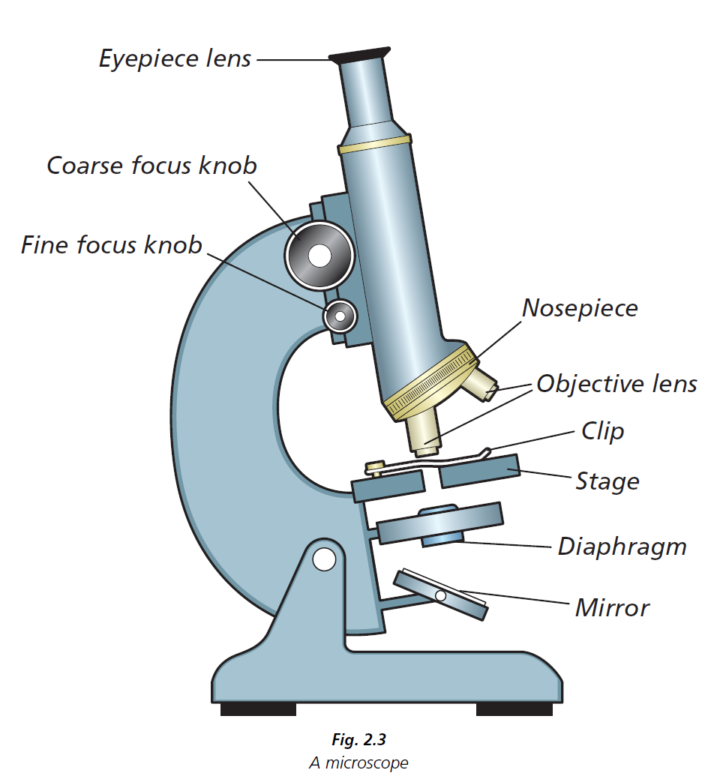

Slide 5
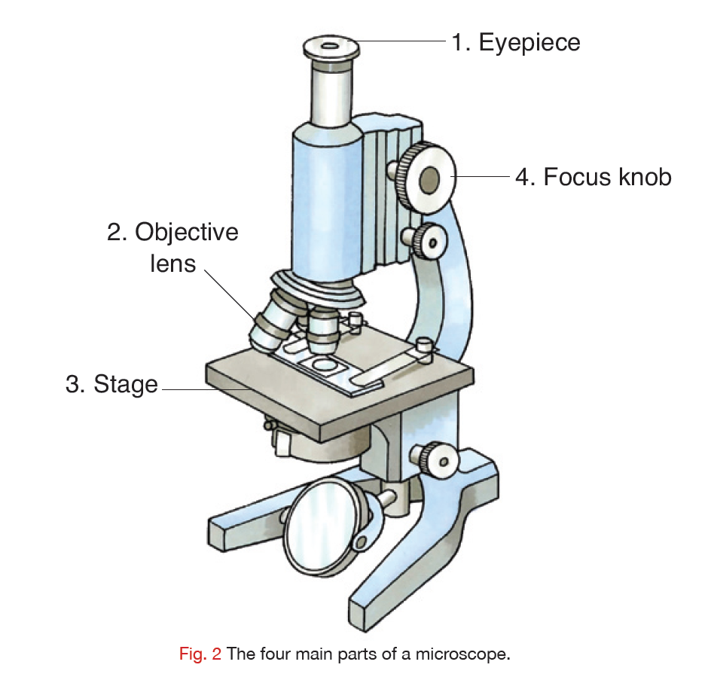

Slide 6
Part of microscope | Function

Slide 7
What are cells?!
Cells are the most basic unit of living organisms.

Slide 8
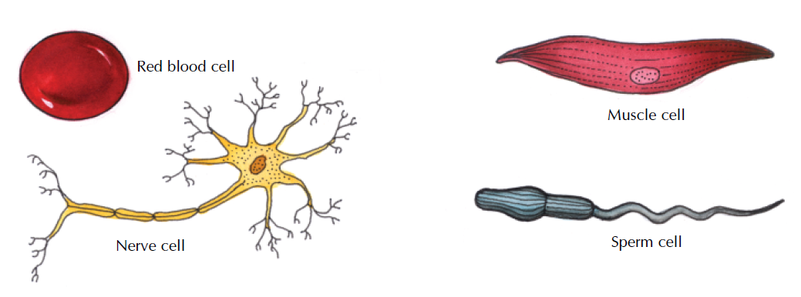
Types of cells:

Slide 9
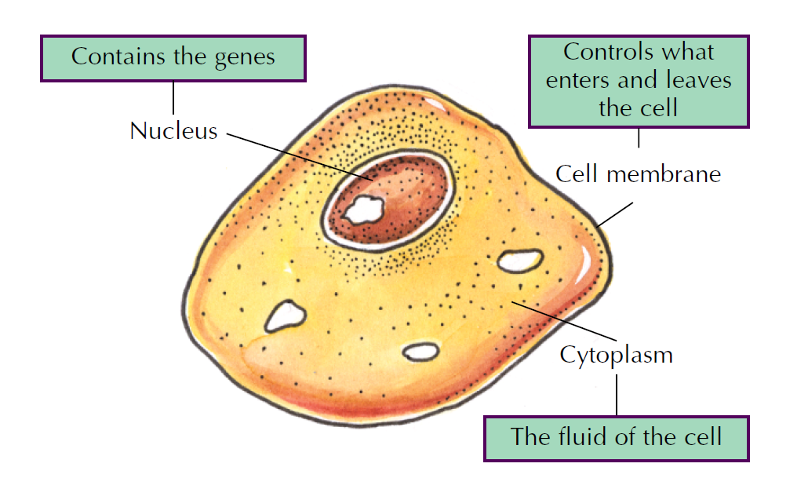
Animal Cell

Slide 11
To examine an animal cell under the microscope
1. Swab inside cheek surface again using a disposable inoculating loop/swab and transfer the sample onto the second slide. Put the loop/swab into the disposal jar. 2. Air dry the slide. 3. Cover the sample with one drop of methylene blue solution. 4. Allow to stand for one minute. 5. Gently, using a wash bottle, wash excess stain from the slide. 6. Apply a cover slip to this preparation as in Fig. 1. 7. Dry the slide carefully with filter paper/absorbent paper and label it. 8. Examine under the microscope

Slide 12
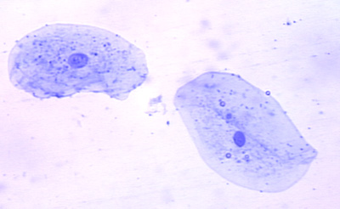
Cheek Cells (Animal Cell)
Cytoplasm
Cell Membrane
Nucleus

Slide 13
Tissues
A tissue is a group of similar cells specialised to carry out a particular job. Muscle cells: form muscle tissue for movement.
Nerve cells: form nerve tissue for rapid transfer of information. Blood: transports materials throughout the body – can be considered to be a complex tissue as it has a number of different cell types.

Slide 14
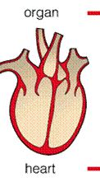
Organs
An organ is a group of tissues working together to carry out a particular job.
Heart: a mixture of muscle and nervous tissue – its job is to pump the blood.
Lungs: their job is to absorb oxygen and excrete carbon dioxide.
Brain: its job is to control the body’s activities, think, learn and make decisions.
Root: anchorage, food storage, water and mineral absorption are its main jobs.
Stem: support the leaves, buds and flowers; food storage,
Leaf: photosynthesis and transpiration.
Organs cannot work by themselves; they depend on other organs to supply things they need.

Slide 15
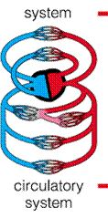
Systems
A system is a group of organs working together to carry out a particular job.
Digestive: oesophagus, stomach, liver, pancreas, small intestine, large intestine. Nervous: brain, spinal cord, nerves, eyes, ears, taste buds, nose, skin, nerves. Circulatory: heart, arteries, veins, blood

Slide 16
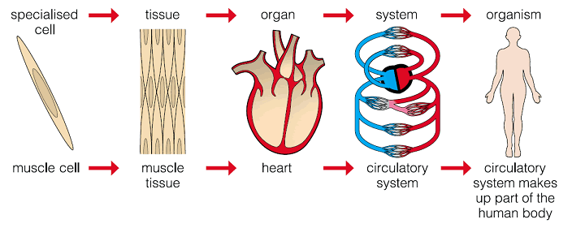

Slide 17
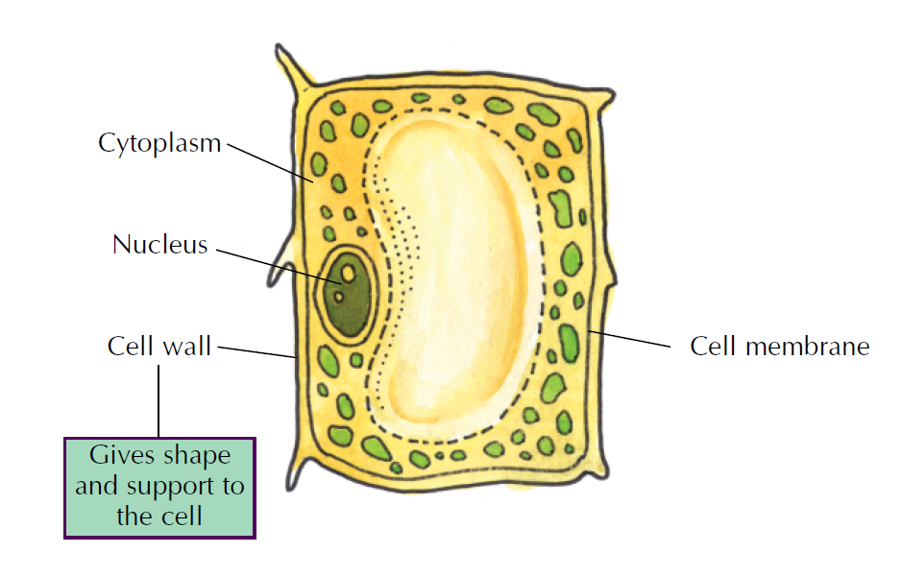
Plant Cell

Slide 18
Part | Function
Cytoplasm | Most of the cell’s activities happen here
Cell membrane | Holds in the contents of the cell and controls what enters and leaves the cell
Nucleus | Controls the activities of the cell
Vacuoles | Store food
Cell wall | Provides support and structure to plant cells
Chloroplasts | These contain chlorophyll which makes food for plant cells

Slide 19
Experiment: To examine a plant cell under the micro-scope

Slide 20
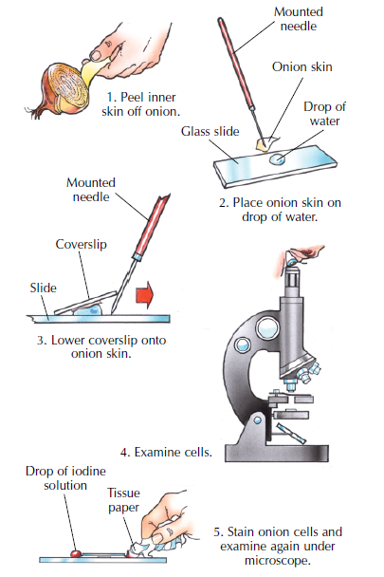

Slide 21
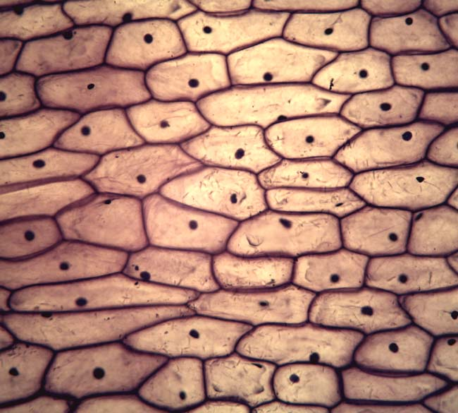

Slide 22
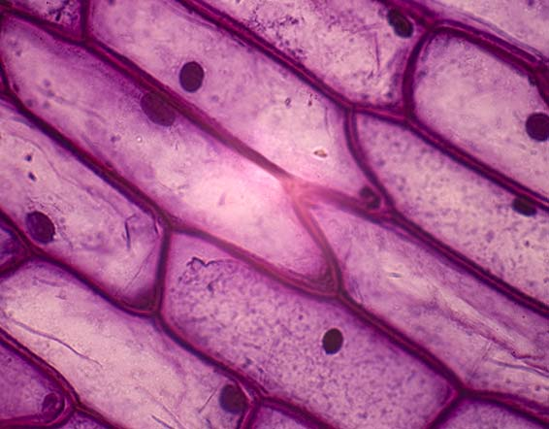

Slide 23
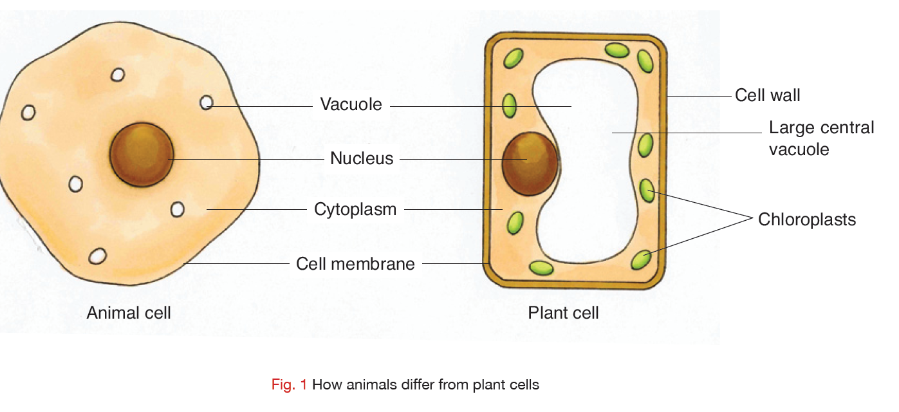

Slide 24
Syllabus
OB42 Identify, and understand the functions of, the main parts of a microscope (light microscope only) and use it to examine an animal cell and a plant cell
OB43 Draw one example each of an animal cell and a plant cell, identifying the nucleus, cytoplasm and cell wall (plant cell), and indicate the position of the cell membrane
OB44 Prepare a slide from plant tissue and sketch the cells under magnification

Slide 25
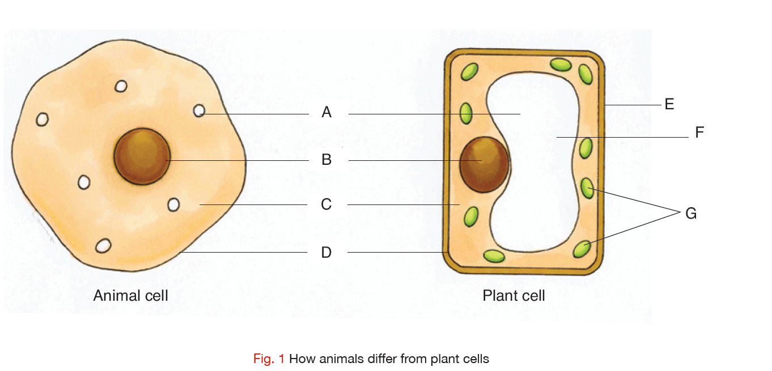

Slide 26
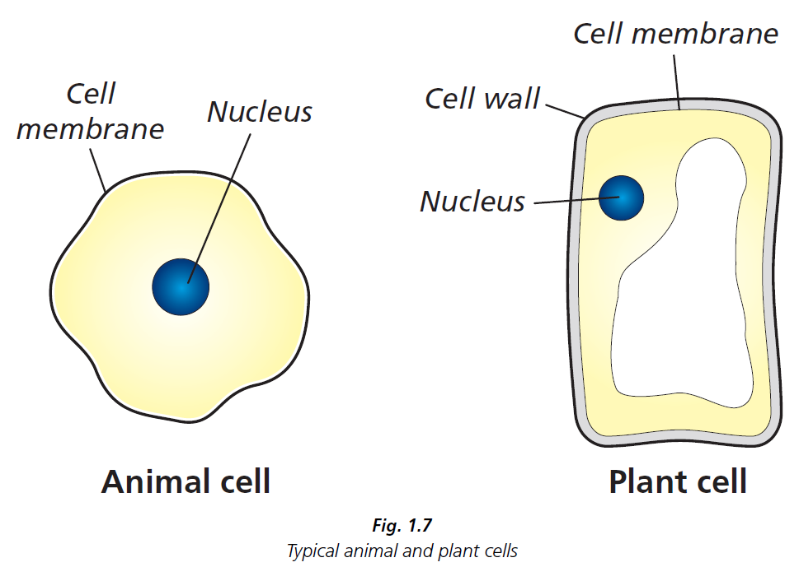

Slide 27
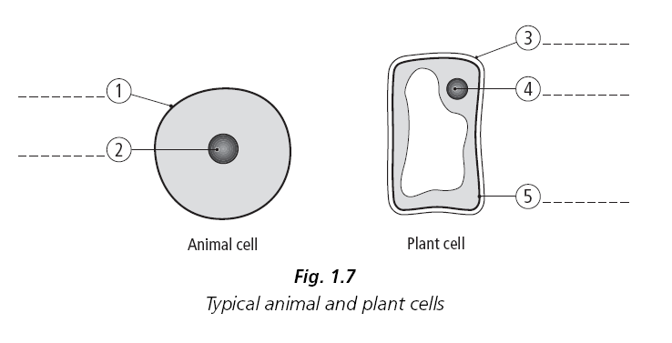
Plant v Animal Cells

Slide 28
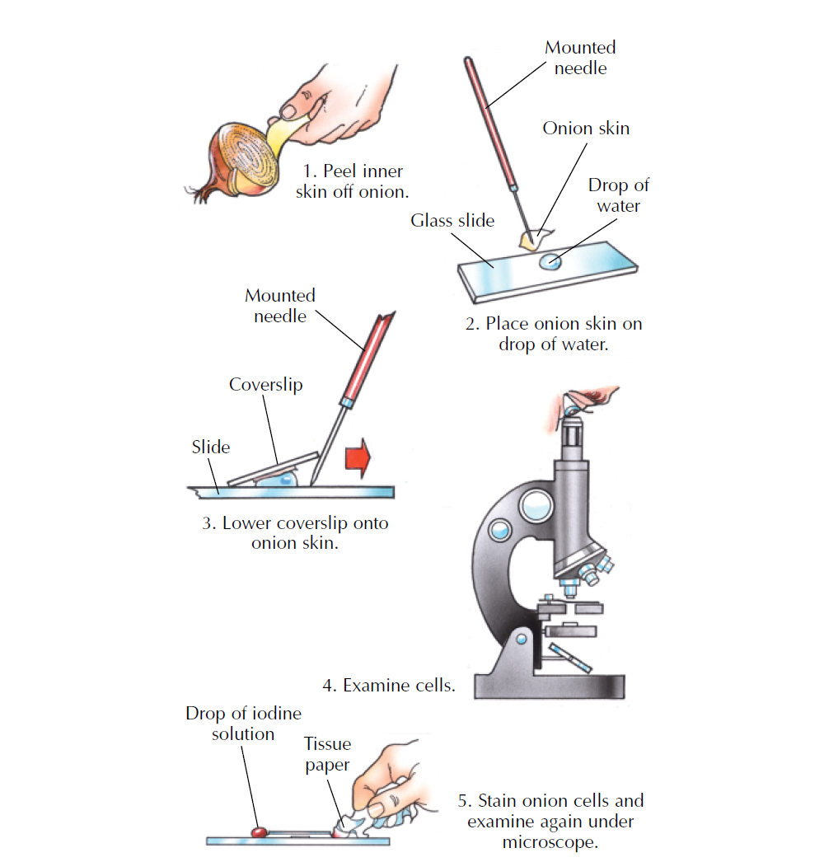

Slide 29
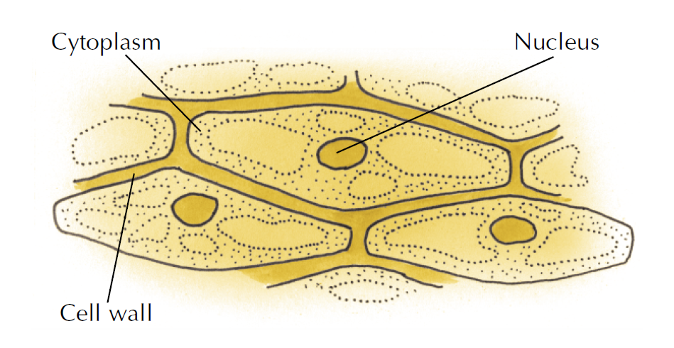

Slide 30
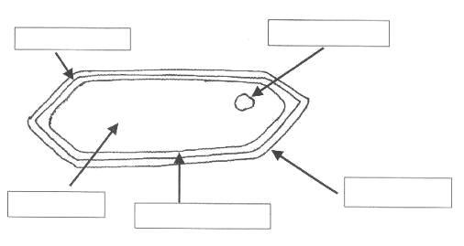
Onion Cell

